Slide 1
Network Basics
Jae Lee

Slide 2
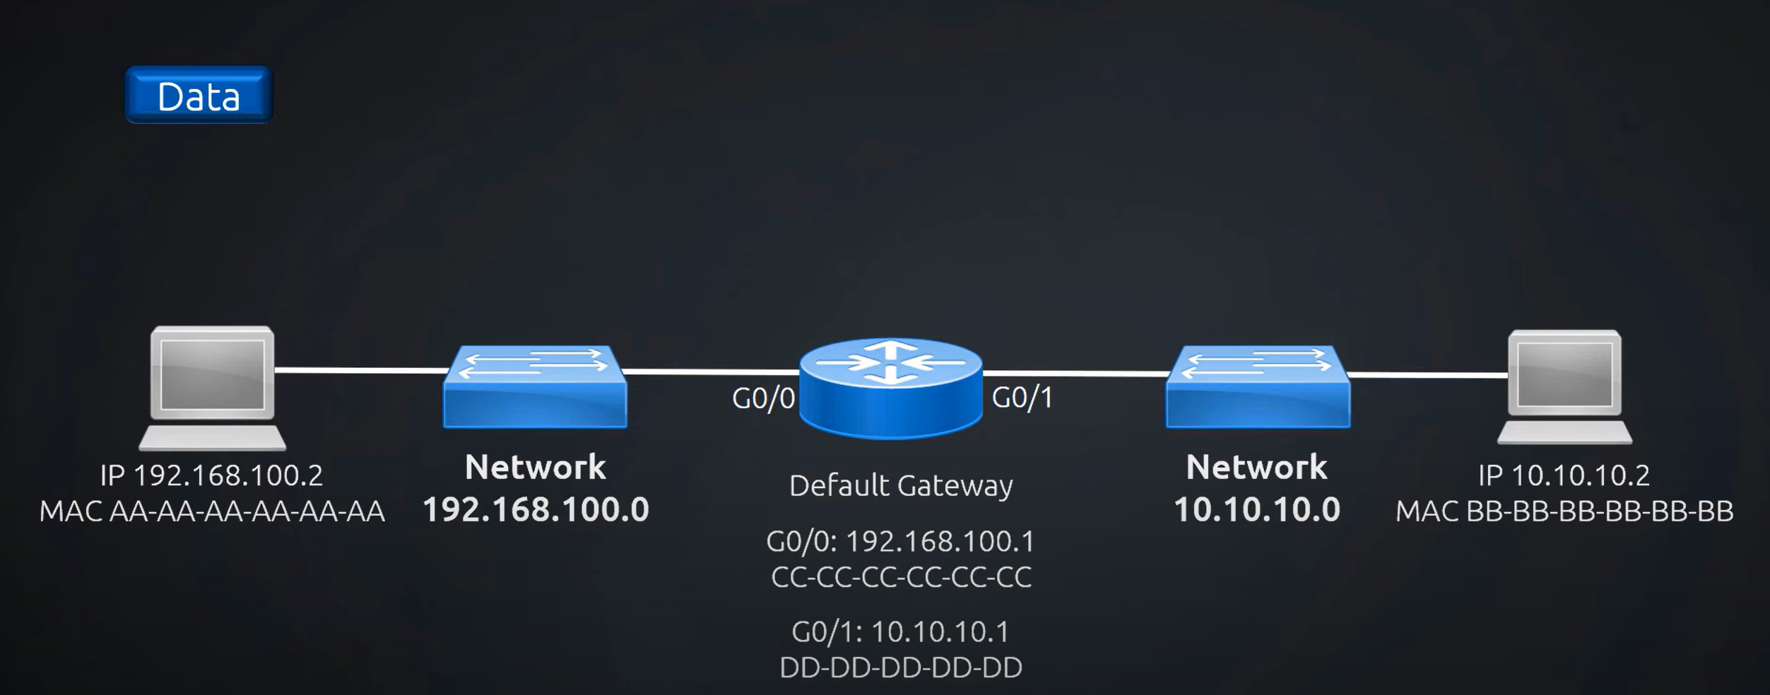
Network

Slide 3
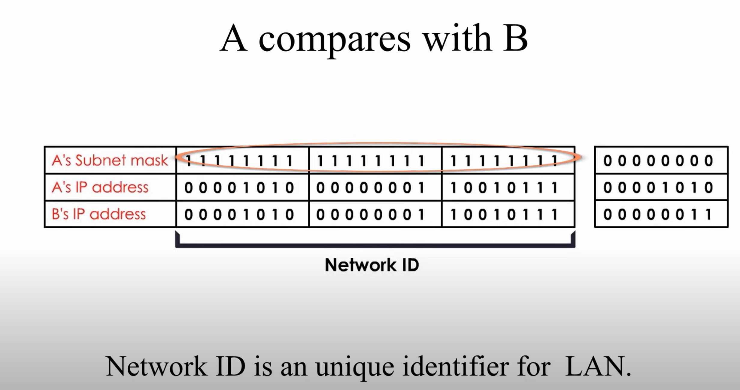

Slide 4
